Slide 1


INTERNET OF THINGS
EXPLOSION RISK DETECTION AND MANAGEMENT SYSTEM
AVINASH N(210701036)
BALAHARINATH C(210701037)
DHARUN PRASATH(210701056)

Slide 2
INTRODUCTION
The Internet of Things (IoT) refers to the network of interconnected devices embedded with sensors, software, and other technologies that enable them to collect and exchange data over the internet. These devices can range from everyday objects like household appliances and wearable gadgets to industrial machinery and smart city infrastructure. The key characteristic of IoT devices is their ability to communicate with each other and with external systems, allowing for remote monitoring, control, and automation of various processes.
This connectivity not only enhances convenience for users but also offers opportunities for energy efficiency, security, and personalized experiences tailored to individual preferences.

Slide 3
LITERATURE SURVEY
Paper: Design and development of Arduino UNO-based Oil And Gas Detection using the internet of things
Author: SA Ajagbe, OA Adeaga, OO Alabi
Year: 2024
Disadvantage: While the system is described as low-cost, it may lack advanced features found in more expensive solutions.
Paper: Light Fidelity-based Oil And Gas Detection System with Arduino UNO
Author: MM Gwani, AM Gimba, MM Kunya
Year: 2024
Disadvantage: The system's reliance on light fidelity may limit its effectiveness in environments with poor lighting conditions.
Paper: Design and Construction of Voice Controlled Oil And Gas Detection using Arduino UNO
Author: UI Ibrahim, H Ohize, UA Umar
Year: 2024
Disadvantage: Voice-controlled systems may suffer from accuracy issues, particularly in noisy environments or with accents that the system may not recognize.

Slide 4
LITERATURE SURVEY
Paper: An Internet of Things-Integrated Oil And Gas Detection with Smart Security System
Author: M Sayeduzzaman, T Hasan
Year: 2024
Disadvantage: Integration challenges in IoT-based systems may lead to compatibility issues between devices and platforms.
Paper: Review and analysis of different automation techniques
Author: KS Rathore, A Raj, H Dixit, K Harsh
Year: 2024
Disadvantage: Some automation techniques may require manual intervention or setup, reducing their efficiency compared to fully automated systems.
Paper: Oil And Gas Detection Using AI Tool
Author: G Vivek, MR Kumar, PAK Reddy, V Sekhar
Year: 2024
Disadvantage: The implementation of AI-based tools may introduce complexity and potential for errors in configuration and operation.

Slide 5
EXISTING SYSTEM
The existing system for explosion risk detection in the oil and gas industry predominantly relies on conventional methods, including manual inspections and periodic monitoring. These methods often involve visual inspections conducted by personnel or the use of handheld sensors and fixed monitoring stations. While these approaches serve as essential safety measures, they present limitations such as labor intensiveness, susceptibility to human error, and restricted coverage of critical areas within the facility. Moreover, these systems may lack real-time data analysis capabilities and predictive functionalities, resulting in delayed response times to potential hazards.
As a consequence, there is a growing demand for more advanced and automated systems that harness the power of emerging technologies such as the Internet of Things (IoT), machine learning, and real-time monitoring. By integrating IoT sensors throughout the facility and implementing machine learning algorithms for data analysis, these systems can provide continuous monitoring, early detection of anomalies, and predictive insights into potential explosion risks. This proactive approach enables operators to swiftly respond to threats, minimize downtime, and ensure the safety and integrity of oil and gas facilities.

Slide 6
PROPOSED SYSTEM
The proposed system is an IoT-based explosion risk detection system designed specifically for the oil and gas industry to enhance safety measures and mitigate potential hazards. It integrates cutting-edge IoT technologies, real-time monitoring capabilities, and predictive analytics to provide early detection and prompt response to abnormal conditions indicative of potential explosion risks.
At the core of the proposed system are IoT sensors strategically placed throughout oil and gas facilities to continuously monitor environmental parameters such as gas levels, temperature, and pressure. These sensors collect data in real-time and transmit it to a central processing unit for analysis.
The data processing unit applies advanced machine learning algorithms to analyze sensor data, identify patterns associated with potential hazards, and generate real-time alerts. These alerts are promptly communicated to relevant personnel via email, SMS, or other communication channels, enabling quick intervention and mitigation measures to be implemented.

Slide 7
REQUIREMENTS
HARDWARE SPECIFICATION
Arduino uno r3
Nodemcu v3 esp8266
Mq-2 sensor
Hc-05 sensor
Breadboards and jumpers
16x2 lcd display
Potentiometer
Resistors batteries
SOFTWARE SPECIFICATION
8 GB RAM
Intel core i5
Node.js with Express.js for backend development
MongoDB for database management

Slide 8
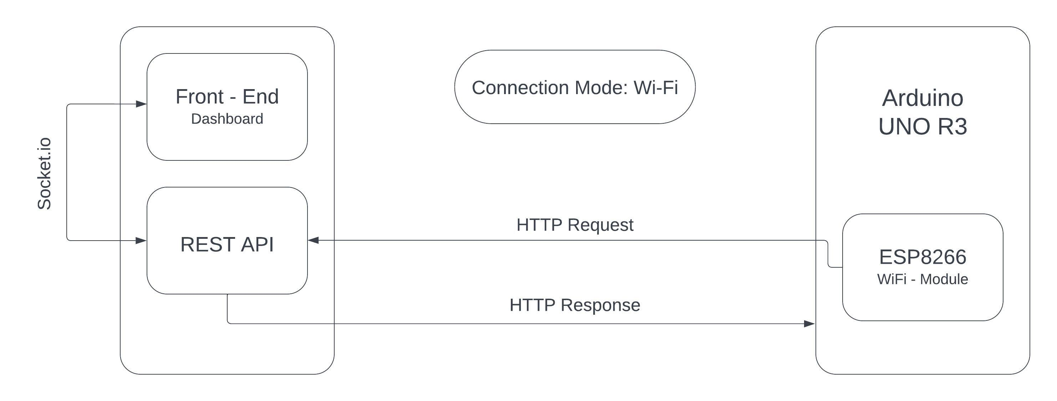
ARCHITECTURE DIAGRAM

Slide 9
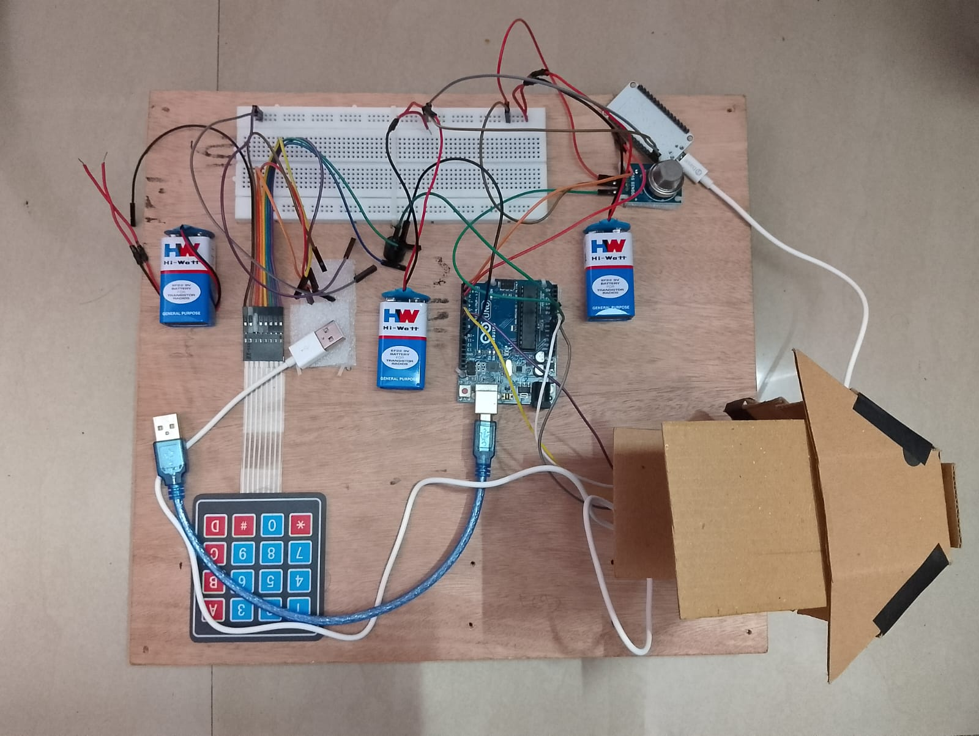
OUTPUT

Slide 10
CONCLUSION
In conclusion, the development and implementation of the IoT-based explosion risk detection system represent a significant advancement in enhancing safety measures within the oil and gas industry. Through real-time monitoring, data analysis, and predictive analytics, the system has demonstrated its effectiveness in mitigating potential hazards and reducing the likelihood of incidents.
The system's ability to continuously monitor environmental parameters and detect abnormal conditions indicative of potential explosion risks has provided invaluable insights into operational safety. Machine learning algorithms applied to sensor data have enabled early identification of patterns associated with potential hazards, facilitating proactive intervention and mitigation measures.

Slide 11
FUTURE ENHANCEMENTS
Future work for the explosion risk detection system in the oil and gas industry presents several avenues for further enhancement and refinement. One key area of focus is the integration of advanced sensor technologies to improve the accuracy and scope of hazard detection. This includes the incorporation of additional sensors capable of detecting a wider range of gases and environmental parameters, as well as the implementation of advanced data fusion techniques to combine data from multiple sources for more comprehensive risk assessment.

Slide 12
REFERENCES
Wanasinghe, T. R., Gosine, R. G., James, L. A., et al. (2020). The internet of things in the oil and gas industry: a systematic review. IEEE Internet of Things Journal.
Ijiga, O. E., Malekian, R., Chude-Okonkwo, U. A. K., et al. (2020). Enabling emergent configurations in the industrial Internet of Things for oil and gas explorations: A survey. Electronics.
Lu, H., Guo, L., Azimi, M., et al. (2019). Oil and Gas 4.0 era: A systematic review and outlook. Computers in Industry.
Aalsalem, M. Y., Khan, W. Z., Gharibi, W., et al. (2017). An intelligent oil and gas well monitoring system based on Internet of Things. IEEE Conference on Radar.

Slide 13
Thank You

